Slide 1
How could you feed 101 Dalmatians?
https://www.youtube.com/watch?v=Wvp-_Jd9fc0

Slide 2
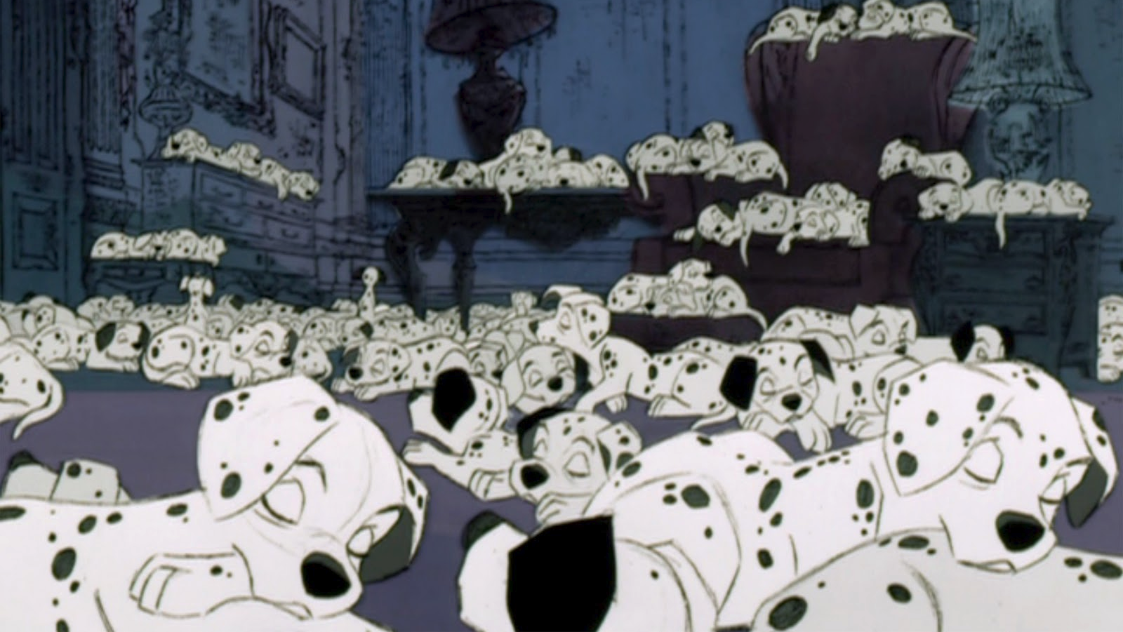
The Situation
At the end of the movie 101 Dalmatians, Roger and Anita adopt all 101 Dalmatians. There are 99 puppies and 2 adult dogs.
How could Roger and Anita feed all these dogs?
What amount of food do they need?
How can they schedule feedings?
How many dog bowls do they need?

Slide 3
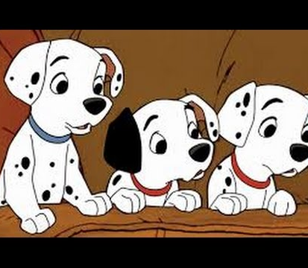
What information do we need to solve the problem?

