Slide 1
The Barracuda and the Damselfish

Slide 2
Barracuda
A barracuda is a large, fast fish that feeds on smaller fish
They can be found in tropical climates
Barracuda can grow up to 3-4 feet in length

Slide 3
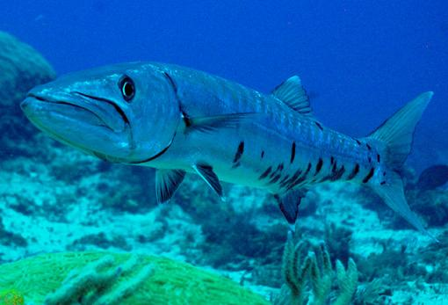
Barracuda

Slide 4
Damselfish
A damselfish is a small tropical fish that lives in a coral reef
Damselfish eat pieces of coral so that algae can grow there
The damselfish eat the algae

Slide 5
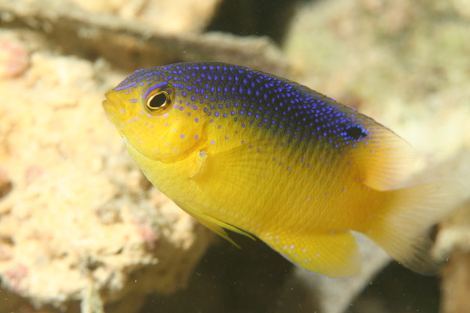
Damselfish

Slide 6
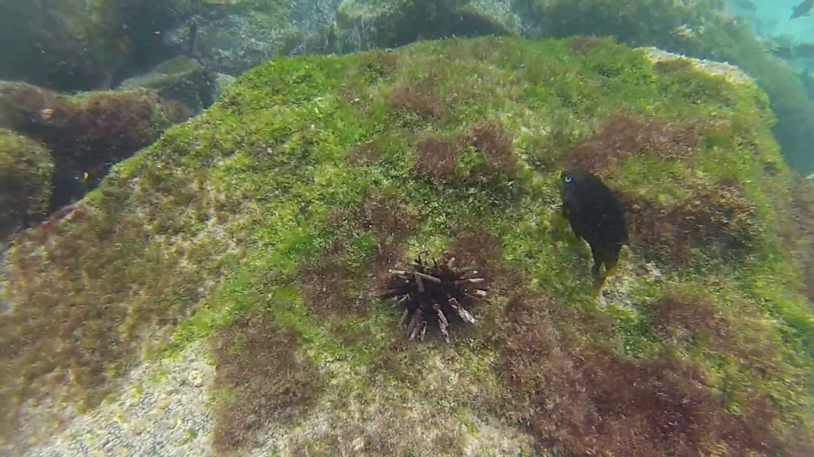
Algae garden

