Slide 1
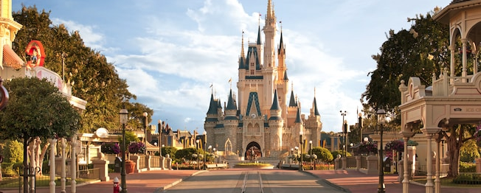
How can you best plan a trip to Walt Disney World?

Slide 2
The Problem
You are planning a trip to Disney World. You want to plan out one day at Disney. You’ll need to plan out:
Rides
Meals
Travel time
What information do you need to solve the problem?

