Slide 1
FSA Information
Third Grade
Mackenzie McNickle

Slide 2
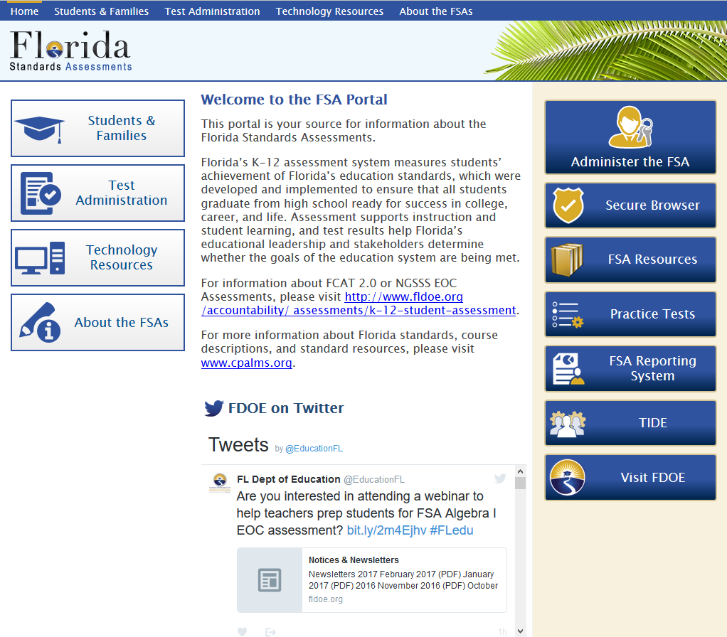
FSA Portal
www.fsassessments.org

Slide 3
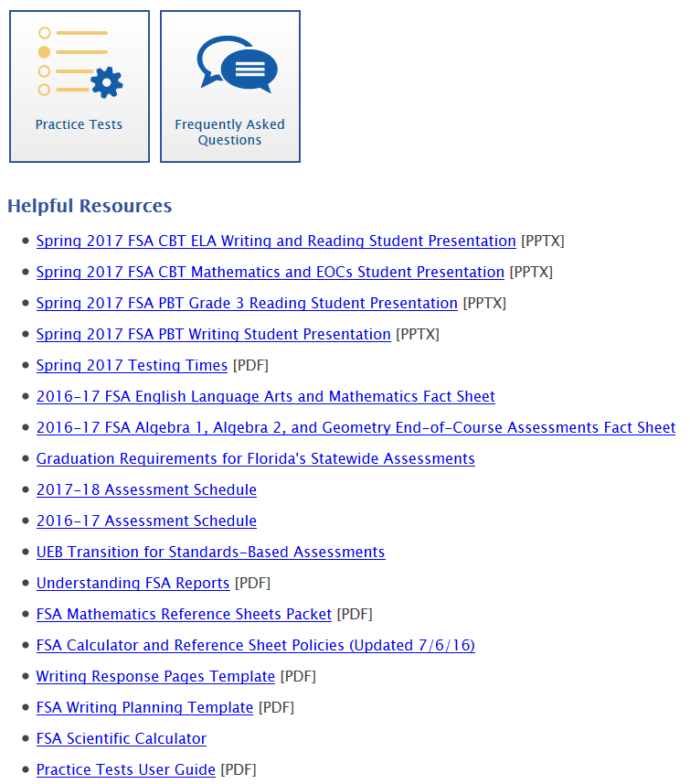
FSA Portal
Go to the “Students and Families” section for great resources to use at home.

Slide 4
Promotion and Graduation Requirements
•Grade 3 students (in order to be promoted to Grade 4):
•Will be required to achieve a certain score on the Grade 3 ELA assessment
•Good cause criteria are still in effect- please speak privately to your child’s ELA teacher if you have questions about good cause promotion

Slide 5
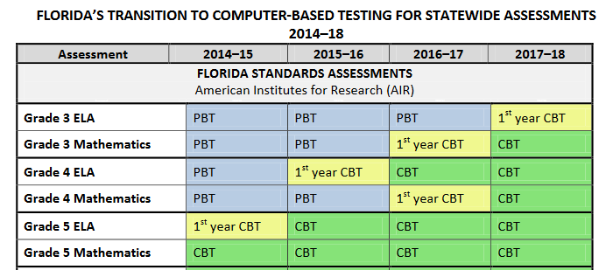

Slide 6
FSA Language Arts Question Types

Slide 7
Question Types
Part A / Part B
Multiple selections (multi-select)
Multiple choice
Sequencing
Editing task

Slide 8
Being “text dependent,” or finding answers directly from the passage, is very important to success on the FSA.

Slide 9
Part A / Part B
Part A: Based on the information in the passage, what is the best material to build your house with?
Straw
Sticks
Bricks
Leaves
Part B: Select the detail from the passage that best supports your answer to part A.
The wolf blew the first pig’s house down.
The first pig said, “Not by the hair on my chinny-chin-chin!”
The wolf could not blow the third pig’s house down.
The wolf blew the second pig’s house down.

Slide 10
Select the sentence.
Select (click on) the sentence from Passage 2 that shows why the man believes that his cheeses can bring themselves to the market.
There was a man of Gotham who filled a sack with cheeses and started off for Nottingham market to sell them. He carried the sack on his back, and when he became tired he sat down by the wayside to rest. Thus he went on until he reached the summit of the last hill he had to climb before he came to Nottingham bridge. There he rested, and when he rose to continue his journey, a cheese slipped out of the sack and rolled down the hill to the bridge.

Slide 11
Part A / Part B
Part A will ask a question about the text.
Part B will typically require the student to identify TEXT EVIDENCE used to answer the question.

Slide 12
Part A
Part B
Lions
Lions are amazing large cats that live in prides of 20-30. Lions are incredible hunters, and are beautiful to watch.
What is the author’s point of view toward lions?
Select evidence from the passage to support your answer to part A.

Slide 13
Multiple selection / Multiselect
Students need to select more than one answer.
Questions will designate how many answers need to be selected.
Common problem: Students not selecting the correct number of answers.

Slide 14
Select two things that you should do to take care of your teeth.
Eat more candy and sweets
Go to the dentist regularly
Avoid brushing your teeth
Brush and floss twice a day

Slide 15
Multiple choice
Traditional multiple choice questions.
Can be part of a Part A / Part B question.

Slide 16
Sequence
Requires the student to put events in order.
Students will be asked to drag and drop events into order.
Common errors: Not looking back in the text to determine answers

Slide 17
Put these events in order to show how you get dressed in the morning.
1
2
3
4
Drag and drop the events into the table in the order in which they happened. 1 should be the first event that happened, and 5 should be the last event that happened.
Put on your socks.
Put on your shoes.
Put on your jeans.
Take your pajamas off.

Slide 18
Vocabulary-Based
What does the word prides mean as used in this paragraph?
Lions are the only cats that live in groups, which are called prides. Prides are family units that may include up to three males, a dozen females, and their young. All of a pride's lionesses are related, and female cubs typically stay with the group as they age.
male lions
groups
cats
satisfaction

Slide 19
Grammar
Tomorrow was the spelling bee. Sam was nervous, so he asked his mom to help him practice. If he worked hard, he knew he could learn all of the ______ [①word’s ② words’ ③ wordes ④ words].

Slide 20
Written Response
What is one way fire ants use their claws and jaws during a flood? Use information from Passage 1 to support your answer.
Write your answer in the space provided below.

Slide 21
ENGLISH LANGUAGE ARTS (ELA) ASSESSMENT REPORTING CATEGORIES

Slide 22
What is the third grade team doing to prepare your child?
Using test prep resources in the classroom daily
Modeling every test after FSA format (weekly reading tests and math assessments)
Basing instruction on the Florida Standards and FSA Test Item Specifications
Administering the AIMS tests, which directly test the standards
Examining data and test results, and modifying instruction accordingly
Math and reading ability groups within and between classrooms
Computer programs: Reflex Math, Fast ForWord, Achieve3000, AR

Slide 23
What Can I Be Doing to Support My Child?
Find a balance between emphasizing the test’s importance and not putting pressure on your child
Review homework together- most of it is FSA prep!
Review weekly math and language arts tests at home with your child
Communicate with teacher(s)- ask for help or extra resources if you need them

