Slide 1
FSA Information
Third Grade
Mackenzie McNickle

Slide 2
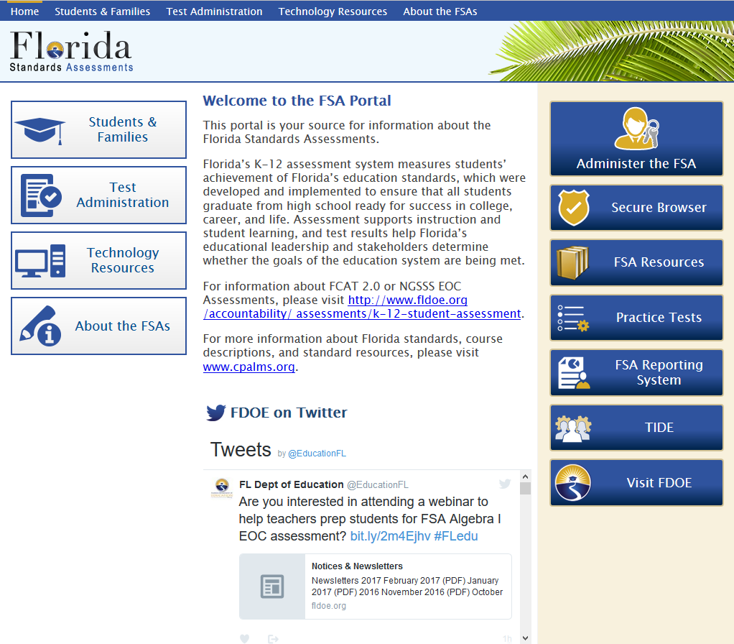
FSA Portal
www.fsassessments.org

Slide 3
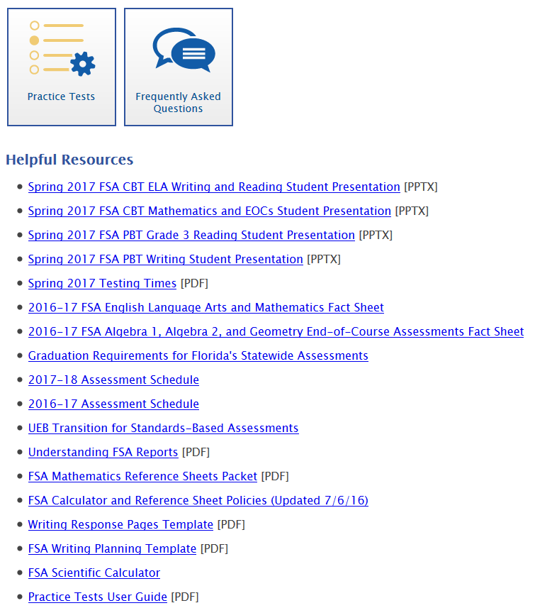
FSA Portal
Go to the “Students and Families” section for great resources to use at home.

Slide 4
Promotion and Graduation Requirements
•Grade 3 students (in order to be promoted to Grade 4):
•Will be required to achieve a certain score on the Grade 3 ELA assessment
•Good cause criteria are still in effect- please speak privately to your child’s ELA teacher if you have questions about good cause promotion

Slide 5
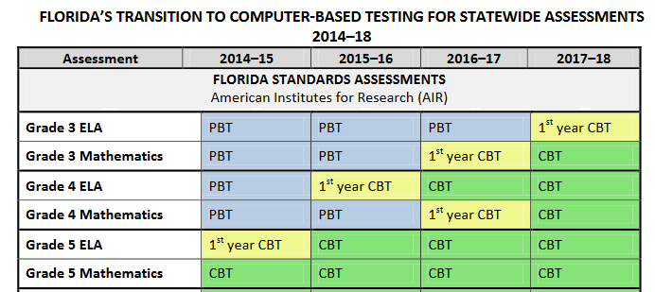

Slide 6
MATHEMATICS ASSESSMENT REPORTING CATEGORIES

Slide 7
There is a lot of emphasis on the math FSA on multiplication and division fact knowledge: this makes up nearly half of the test!

Slide 8
Match each number to the value of the number rounded to the nearest 10.

Slide 10
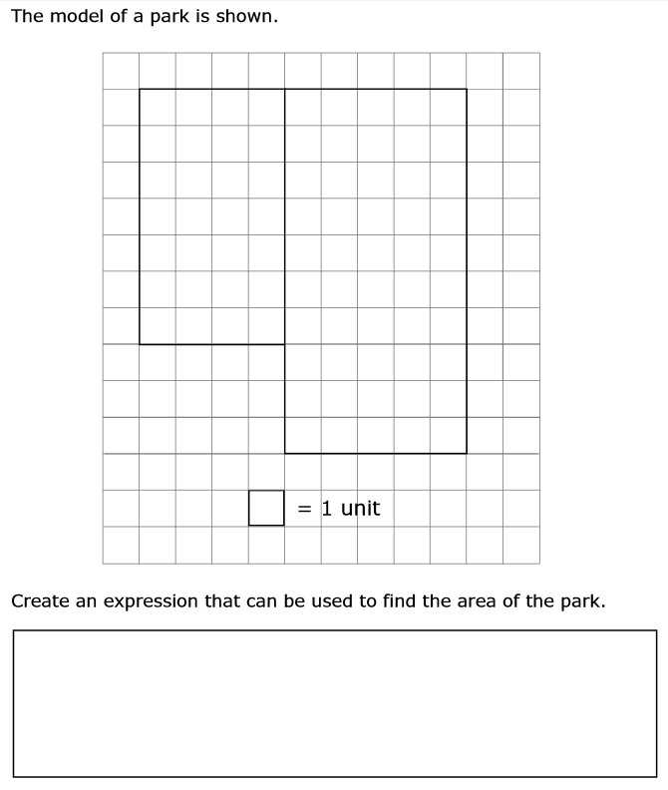

Slide 13
What is the third grade team doing to prepare your child?
Using test prep resources in the classroom daily
Modeling every test after FSA format (weekly reading tests and math assessments)
Basing instruction on the Florida Standards and FSA Test Item Specifications
Administering the AIMS tests, which directly test the standards
Examining data and test results, and modifying instruction accordingly
Math and reading ability groups within and between classrooms
Computer programs: Reflex Math, Fast ForWord, Achieve3000, AR

Slide 14
What Can I Be Doing to Support My Child?
Find a balance between emphasizing the test’s importance and not putting pressure on your child
Review homework together- most of it is FSA prep!
Review weekly math and language arts tests at home with your child
Communicate with teacher(s)- ask for help or extra resources if you need them

