Slide 1
The Genip Tree and the Mangrove

Slide 2
Genip trees (guh-NIP)
A genip tree can grow to 80 feet tall
Genips are small, sweet and sour fruits that have many names depending on what country you’re in!
http://www.dictionary.com/browse/genip

Slide 3
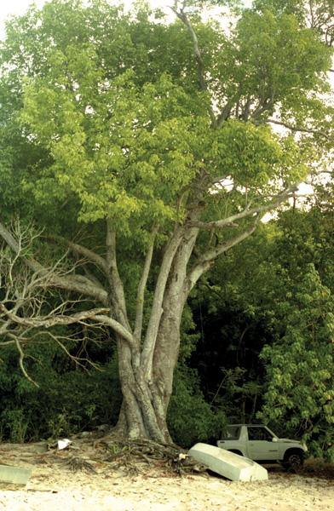
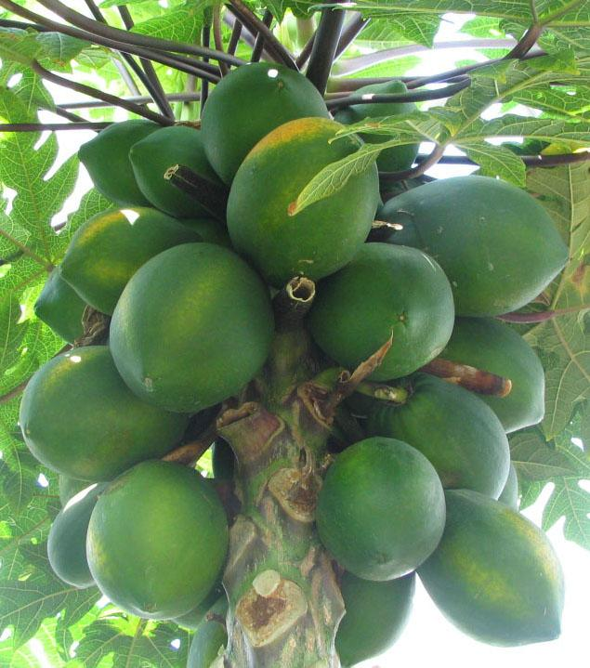

Slide 4
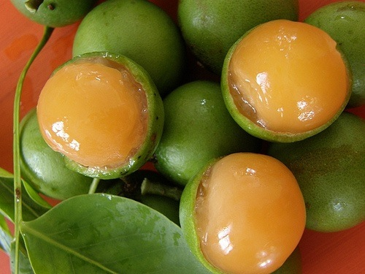
To eat a genip, you peel off the green skin and suck out the fruit inside. It is sweet and sour!

Slide 5
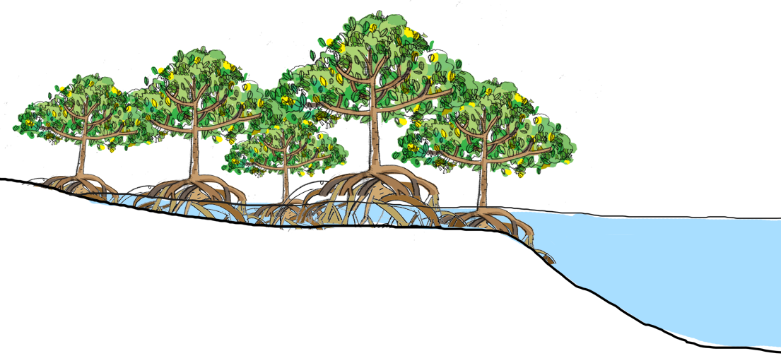
Mangrove tree
Mangrove trees grow in salty waters
Mangroves have propped roots which stick out of the water and provide shelter to animals
http://www.dictionary.com/browse/mangrove?s=t

Slide 6
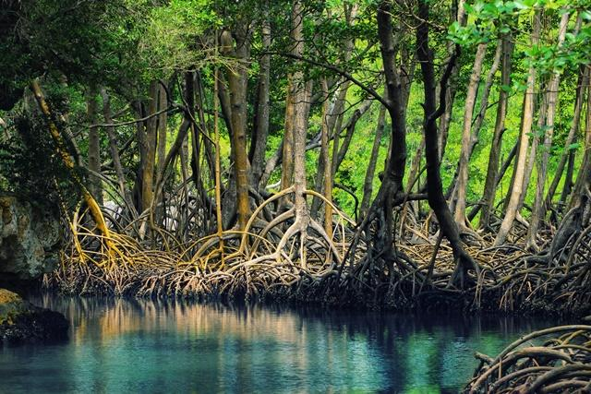

Slide 7
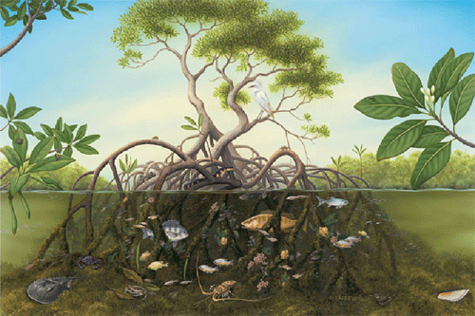

Slide 8
What is the central message of this story?
Who learned a lesson?
How do you know?

