Slide 1

What are
Technology Enhanced
Item Questions ???
Vamadria “Mondie” Johnson, M.Ed.
ACPS Elementary Math Curriculum Specialist
johnsonvm@gm.sbac.edu
September 2016
3rd Grade

Slide 2
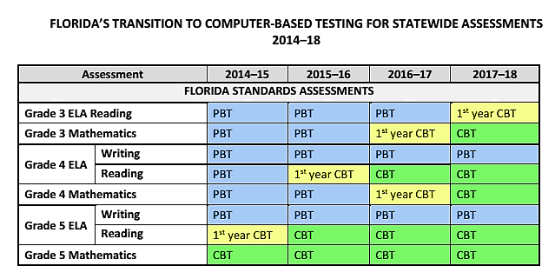
Florida’s Transition to FSA Computer-Based Testing
This is the first year that third and fourth grade will take the Math Florida Standards Assessments on the Computer.

Slide 3
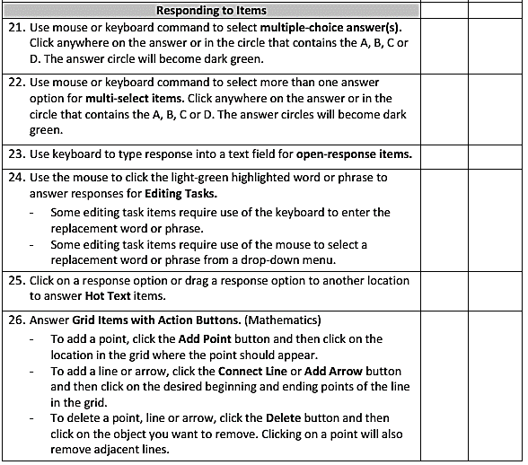

Technology Skills Checklist for FSA Computer-Based Testing: Responding to Items……

Slide 4
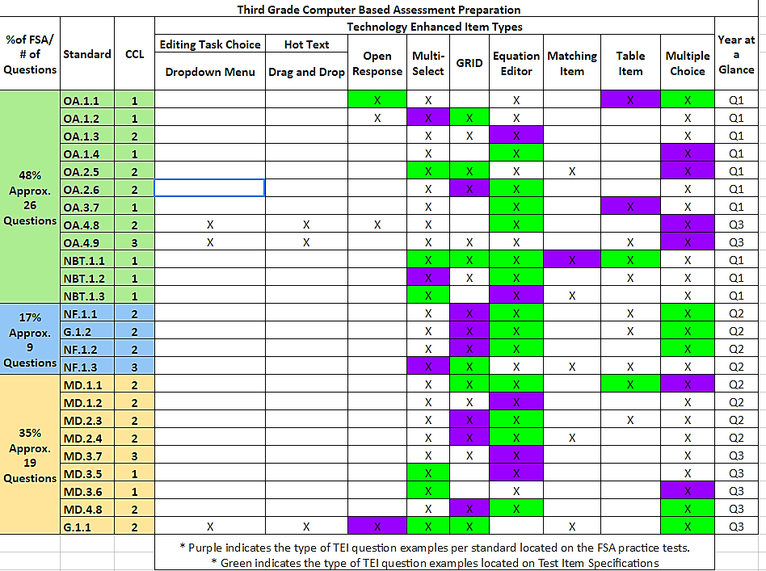
Technology Enhanced Item Types per Standard
FSA Test Design Summary
The quarter in which the standard is taught
Located on the FSA Practice Test
Cognitive Complexity Level of the Standard
Located on the Test Item Specs
Purple = FSA Practice Test
Green = Test Items Specs

Slide 5
FSA questions could contain a combination of the following items…

Slide 6
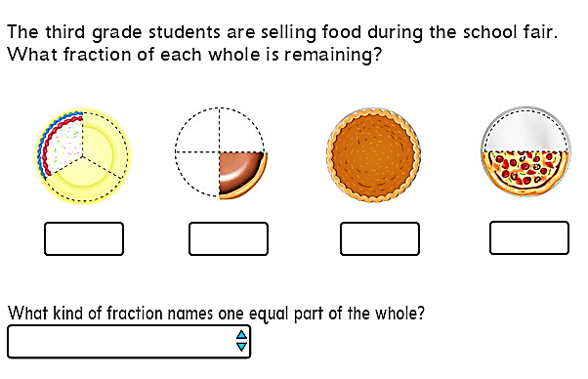
Editing Task Choice/ Dropdown Menu
The student clicks a highlighted item, which reveals a drop‐down menu containing options to solve the problem. The student, then, selects the correct answer from the drop‐down menu.
This is an example of the TEI but does not exemplify a standard that might use editing task choice.
It maybe visible on the FSA for
the following standards:
OA.4.8, OA.4.9, G.1.1

Slide 7
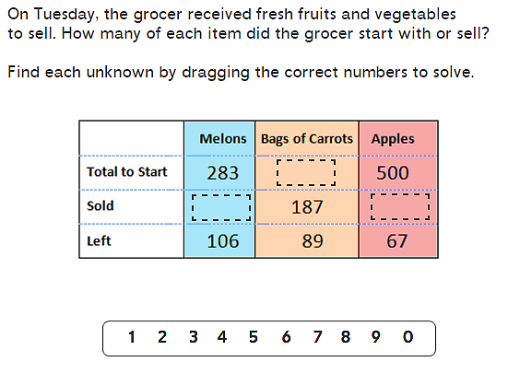

Hot Text/ Drag and Drop
Certain items are designed to move:
Hover over the area and the text with highlight.
Click on the option.
Hold down the mouse button.
Drag it to a graphic or other format.
It maybe visible on the FSA for
the following standards:
OA.4.8, OA.4.9, G.1.1
177
3.OA.4.8 My Math-connected.mcgraw-hill.com

Slide 8
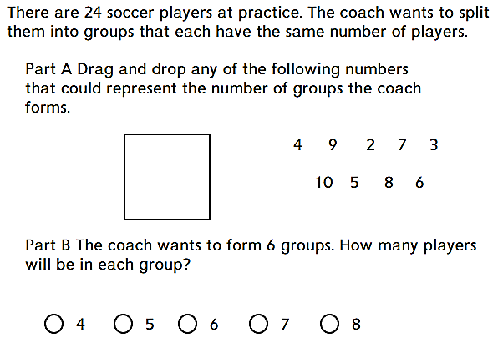
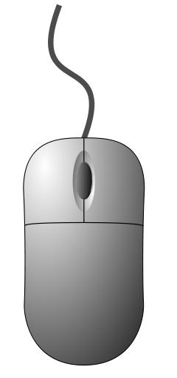
Hot Text/
Drag and Drop
Practice in Quarter 3 for standards OA.4.8, OA.4.9, G.1.1
3.OA.4.8 My Math-connected.mcgraw-hill.com

Slide 9
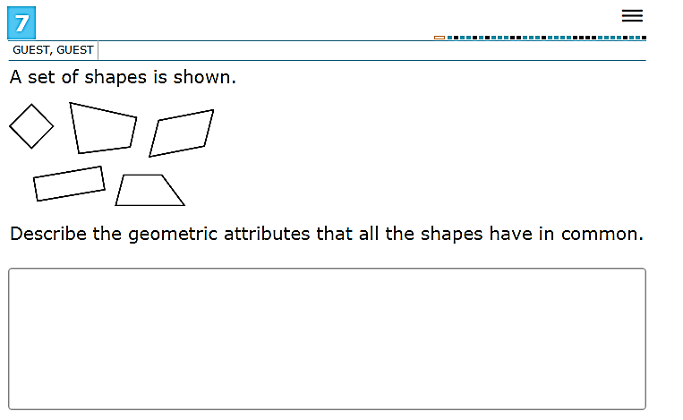

Open Response
Use keyboard to enter a response into text field
3.G.1.1 FSA Practice Test-fsaassessments.org

Slide 10
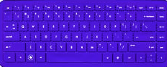
Open Response
Tom told Mary he planted 4 X 5 flowers. How might Mary describe the arrangement of flowers in Tom’s rectangular-shaped garden?
Type Response
3.OA.1.1 Test Item Specifications

Slide 11
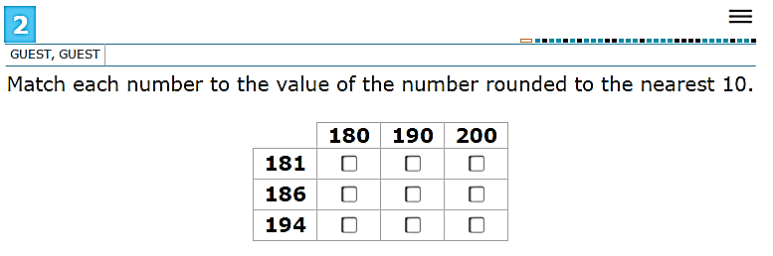

Matching
The student checks a box to indicate if information from a column header matches information from a row.
3.NBT.1.1 FSA Practice Test-fsaassessments.org

Slide 12
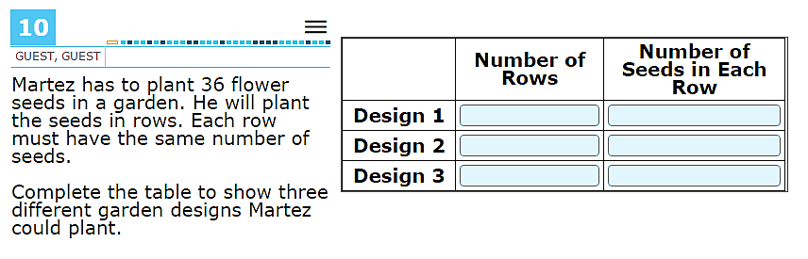

Table Item
The student types numeric values into a given table. The student may complete the entire table or portions of the table depending on what is being
asked.
3
12
3.OA.1.1 FSA Practice Test-fsassessments.org

Slide 13
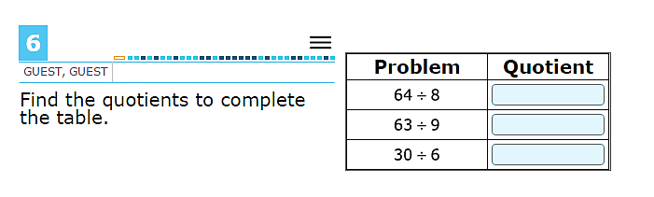
Table Item
8
3.OA.3.7 FSA Practice Test-fsaassessments.org

Slide 14
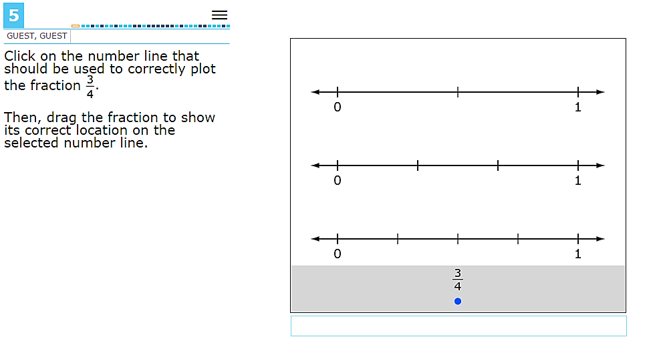
Graphic Response Item Display (GRID)
The student selects numbers or images and uses the drag‐and‐drop feature to place them into a graphic.
3.NF.1.2b FSA Practice Test-fsaassessments.org

Slide 15
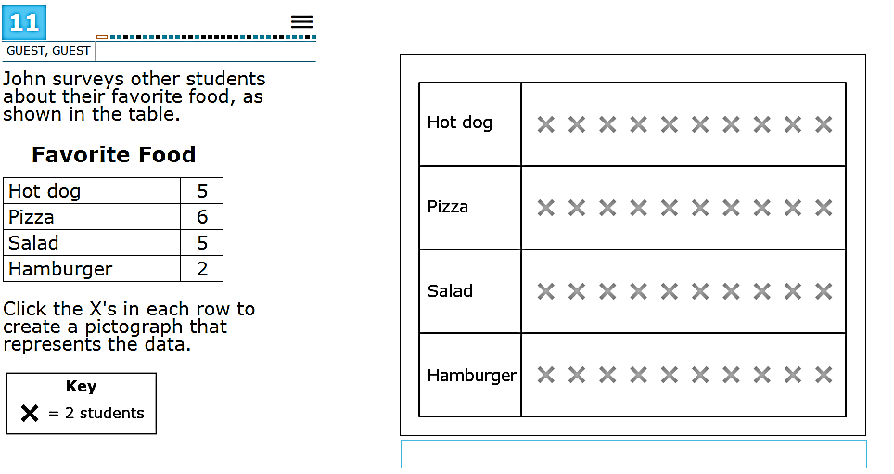
Graphic Response Item Display (GRID)
This item type may also require the student to use the point, line, or arrow tools to create
a response on
a graph.
3.NF.1.1 FSA Practice Test-fsaassessments.org

Slide 16
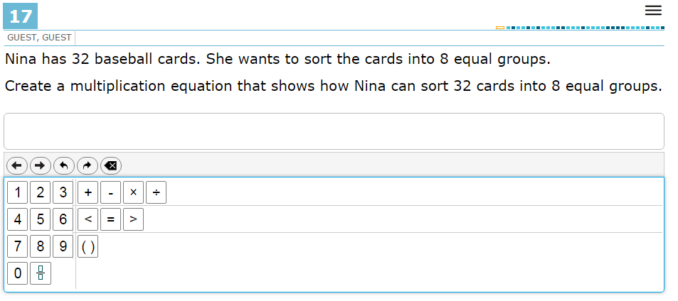
Equation Editor
This TEI should be practiced with every standard
The student is presented with a toolbar that includes a variety of mathematical symbols that can be used to create a response.
Responses may be in the form of a number, variable, expression, or equation, as appropriate to the test item.
4 x 8
3.OA.1.3 FSA Practice Test-fsaassessments.org

Slide 17
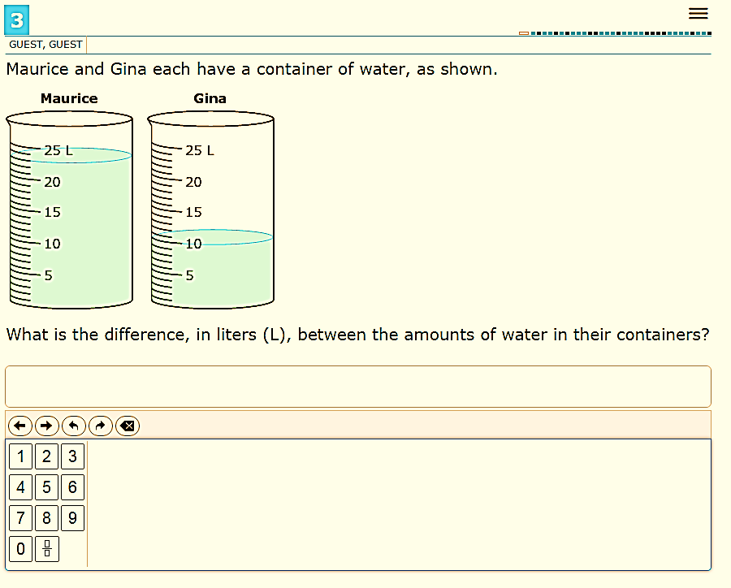
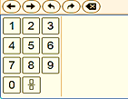
Equation Editor
This TEI should be practiced with every standard
15 liters
3.MD.1.2 FSA Practice Test-fsaassessments.org

Slide 18
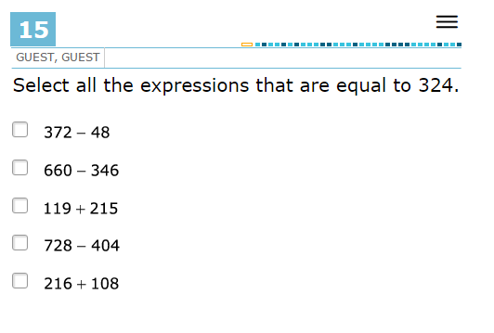
Multi-Select
This TEI should be practiced with
every standard
Students are directed to select all of
the correct answers from
among a number of options.
This item is different from multiple-choice items, which allow the student to select only one correct answer
Notice that there are checkboxes instead of circles.
3.NBT.1.2 FSA Practice Test-fsaassessments.org

Slide 19
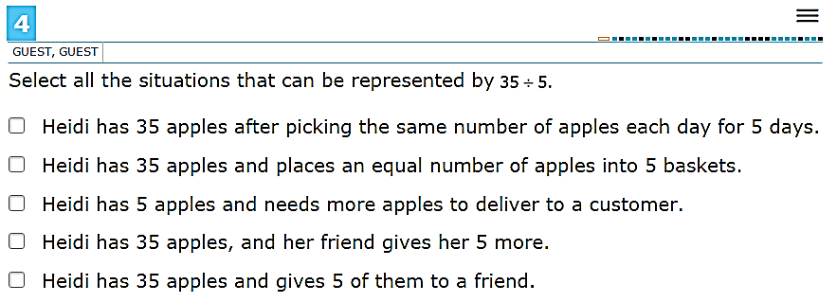
Multi-Select
This TEI should be practiced with
every standard
3.OA.1.2 FSA Practice Test-fsaassessments.org

Slide 20
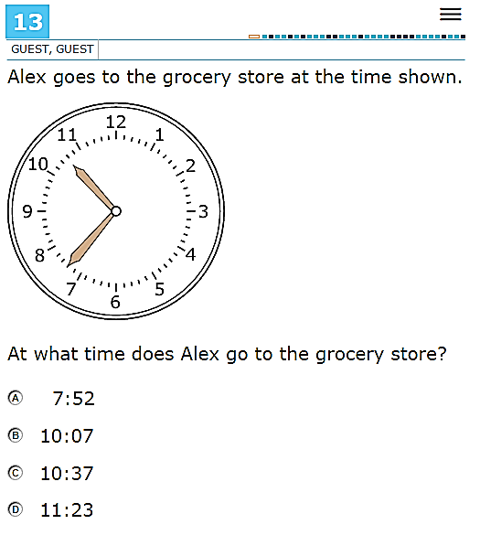
Multiple Choice
This TEI should be practiced with
every standard
The student will select only one correct answer.
Notice that there are circles instead of boxes.
3.MD.1.1 FSA Practice Test-fsaassessments.org

Slide 21
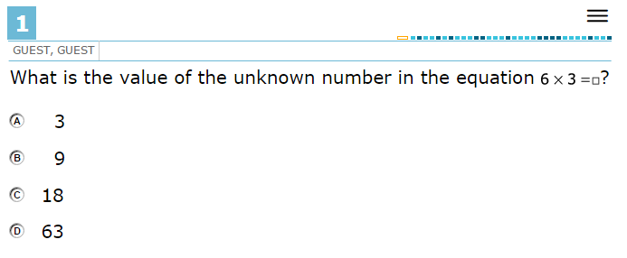
Multiple Choice
This TEI should be practiced with
every standard
3.OA.1.4 FSA Practice Test-fsaassessments.org

Slide 22
FSA Updates
FSA Mathematics Testing occurs over 2 days.
Students will have 2 sessions, 80 minutes each.
Grade 3 will not have any conversions or formulas.
Each student will be given a blank four page work folder. The last page of the work folder is graph paper.

Slide 23

Rulers on the FSA
Questions that require a ruler or protractor, will have the tool embedded in the question.
Students may have to drag the tool on/next to what needs to be measured.

Slide 24


RESOURCES
Florida Standards
Test Item Specifications
fsassessments.org

Slide 25

Thank you!
Questions?
Please contact me at
@ACPS_Math&johnsonvm@gm.sbac.edu

