Slide 1
How Many Movies can you see in one day?

Slide 2
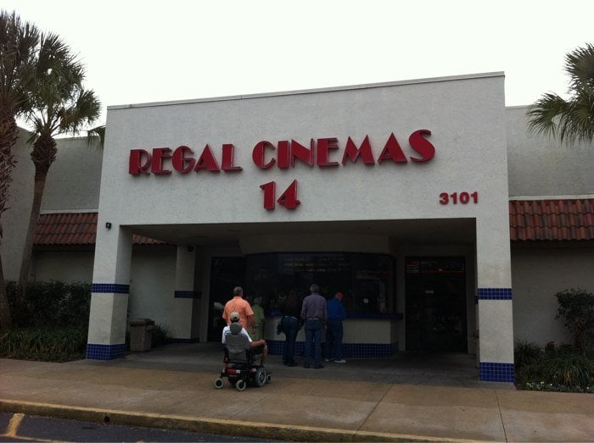
The Problem
How many movies could you see in one day?
What information do we need to solve this problem?

Slide 3
Movie Schedules
https://mobile.fandango.com/regal-butler-town-center-14-aaeqx/theater-page

