Slide 1
Do we have enough paint?

Slide 2
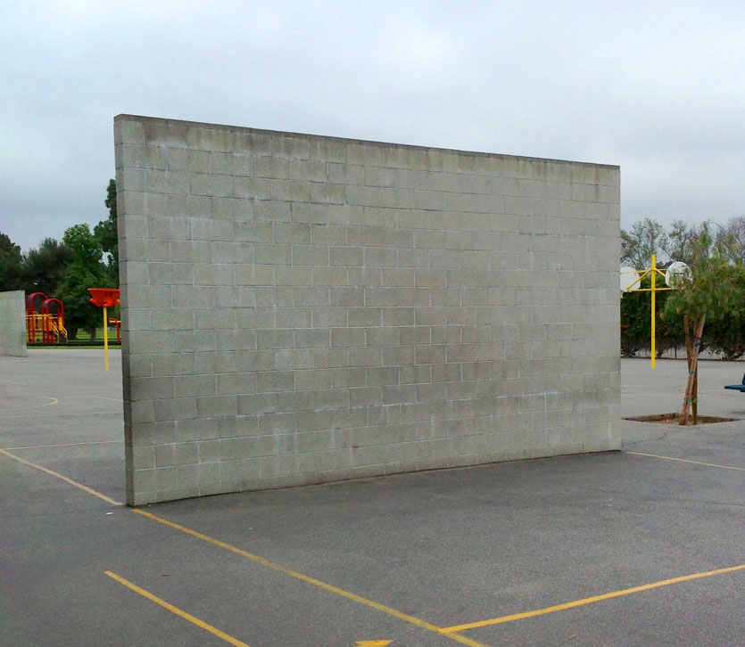
The Situation
Your class wants to paint one side of the handball wall below. You already have one full can of paint.

Slide 3
The Challenge
How can we figure out if we have enough paint?
Do we have enough paint?
Do we have enough paint for a second coat?

Slide 4
What information do we need to solve the problem?

Slide 5
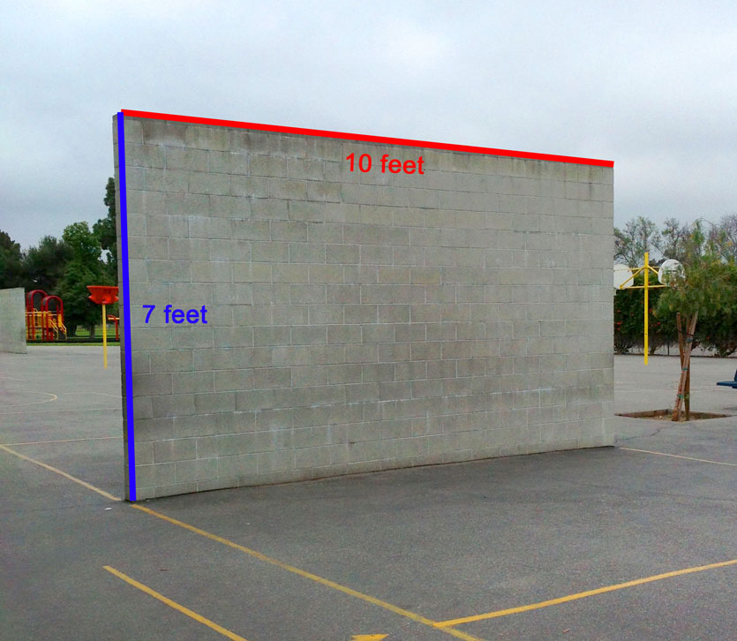

Slide 6
