Slide 1
The Shark and the Parrotfish

Slide 2
Nurse Shark
Many sharks have to swim all the time in order to stay alive, but the nurse shark does not
Nurse sharks live on the bottom of the ocean’s floor in shallow waters
They are not aggressive and eat small fish and other ocean life
https://www.youtube.com/watch?v=YxooxSHIQ8U

Slide 3
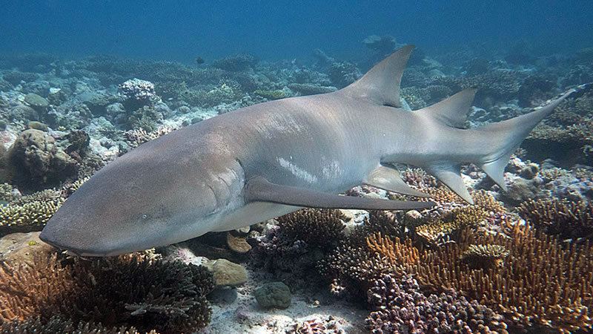

Slide 4
Parrotfish
They can make a bubble out of mucus for protection at night. The bubble masks their scent, making it difficult for predators to find them
Parrotfish eat algae off of coral and rock, and chew up coral and rock into sand
https://www.youtube.com/watch?v=8T-gnZevlaY

Slide 5
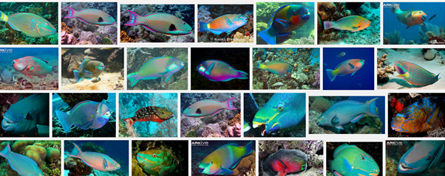
Parrotfish exist in a wide variety of colors!

Slide 6
What is the central message of this story?
Who learned a lesson?
How do you know?

