Slide 1
How can you win a lot of tickets at Chuck E. Cheese’s?

Slide 2
The Situation
Chuck E. Cheese’s (and many other arcades) have a game called Skee-Ball where you roll a ball up a ramp and into a hole to earn points. You earn more points when the ball goes into smaller holes. The more points you earn, the more tickets you get to buy prizes with. As a bonus, if you earn at least 450 points, you win their grand prize which gives you as many as thousands of tickets.

Slide 3
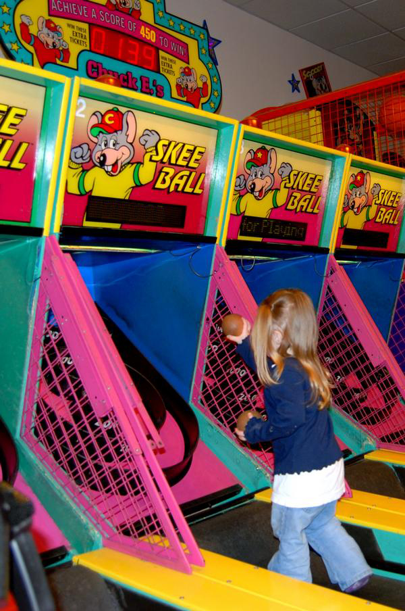
This girl is playing Skee-Ball. Is she playing correctly?
What is the number of tickets you will get if you get the high score?
What is the high score?

Slide 4
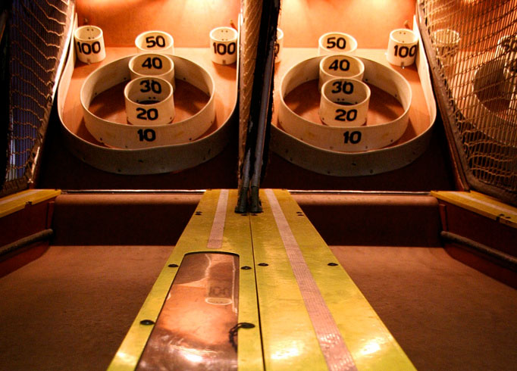
What do you notice about the Skee-Ball?
Are you thinking of any strategies to maximize your number of points?

Slide 5
The Challenge
How can you get 450 points playing Skee-Ball and win the grand prize?

Slide 6
Consider this:
One round of Skee-Ball uses 9 balls. In reality, kids often throw the balls into another lane, so sometimes you have more or less than 9.
The game ends when 9 balls go back into the machine, so throwing additional balls from other lanes is not an option for getting more points.

Slide 7
Consider this:
Earning 100, 50, 40, 30, and 20 points is fairly obvious as the ball has to go down the corresponding hole. However, when you don’t make it into 100, 50, 40, 30, or 20 points, there is a big curve to catch all the falling balls. This curve empties into the 10 points hole. So, if you miss one of the higher scoring holes, you will almost always earn at least 10 points when it falls down.

Slide 8
Consider this:
The grand prize goes up one ticket every time someone plays the game without winning the grand prize. So, it could conceivably go very high. When the grand prize is won, it goes back down to 100 tickets so it is still a good bonus. You also win the tickets for the 450 points.

Slide 9
What would happen?
What is the high score you need?
What would happen if you rolled a 100?
How hard is it to roll a 100?
What happens if you miss every shot?

