Slide 1
What is our solar system?
The Sun
The eight planets that orbit the sun
The moons that orbit the planets
Other objects
- asteroids
- comets

Slide 2
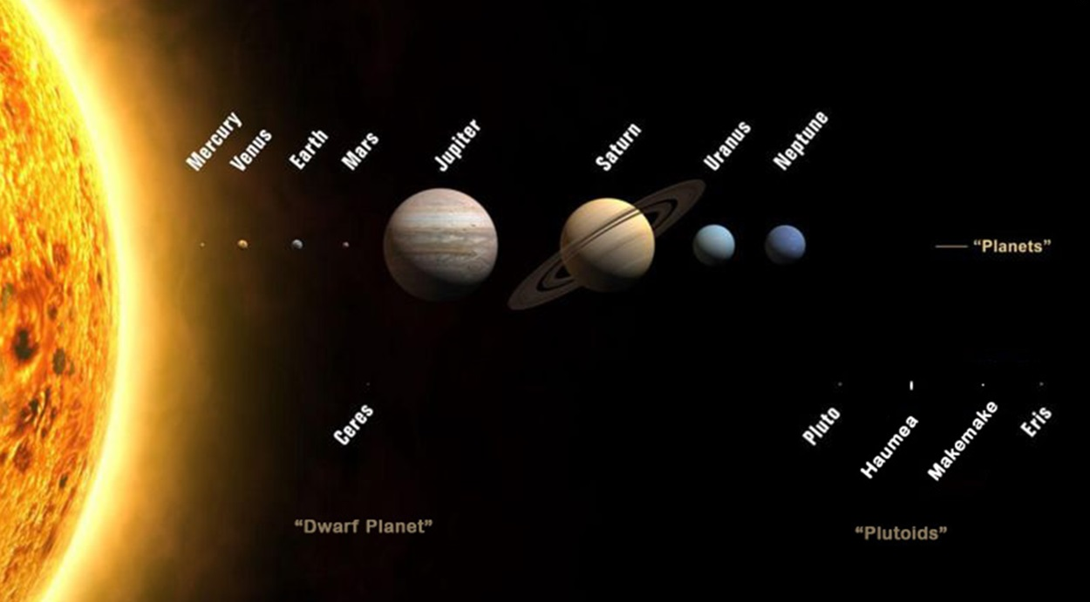

Slide 3
What is a star?
A ball of hot gas that gives off energy
The Sun is the star at the center of our solar system

Slide 4
Let's learn about our Sun!
What do you already know about the Sun?
Why is the Sun important to life on Earth?

Slide 5
More about the Sun!
The Sun is extremely hot!
The Sun is extremely bright!
The Sun is very far away!
The Sun is HUGE!

Slide 6
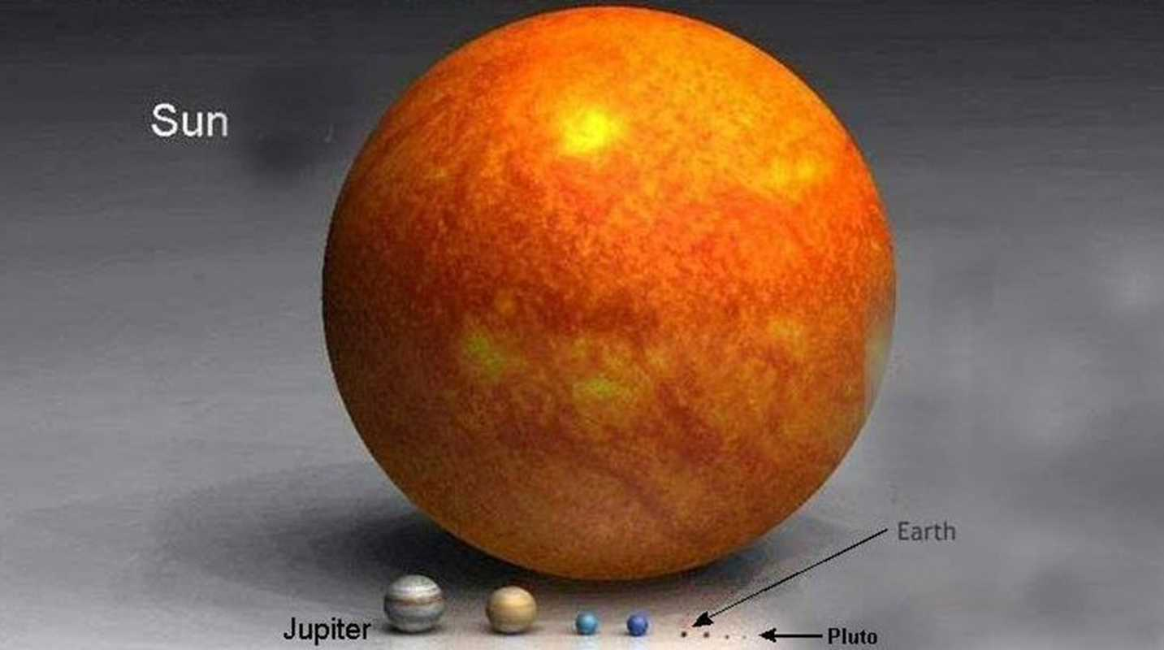

Slide 7
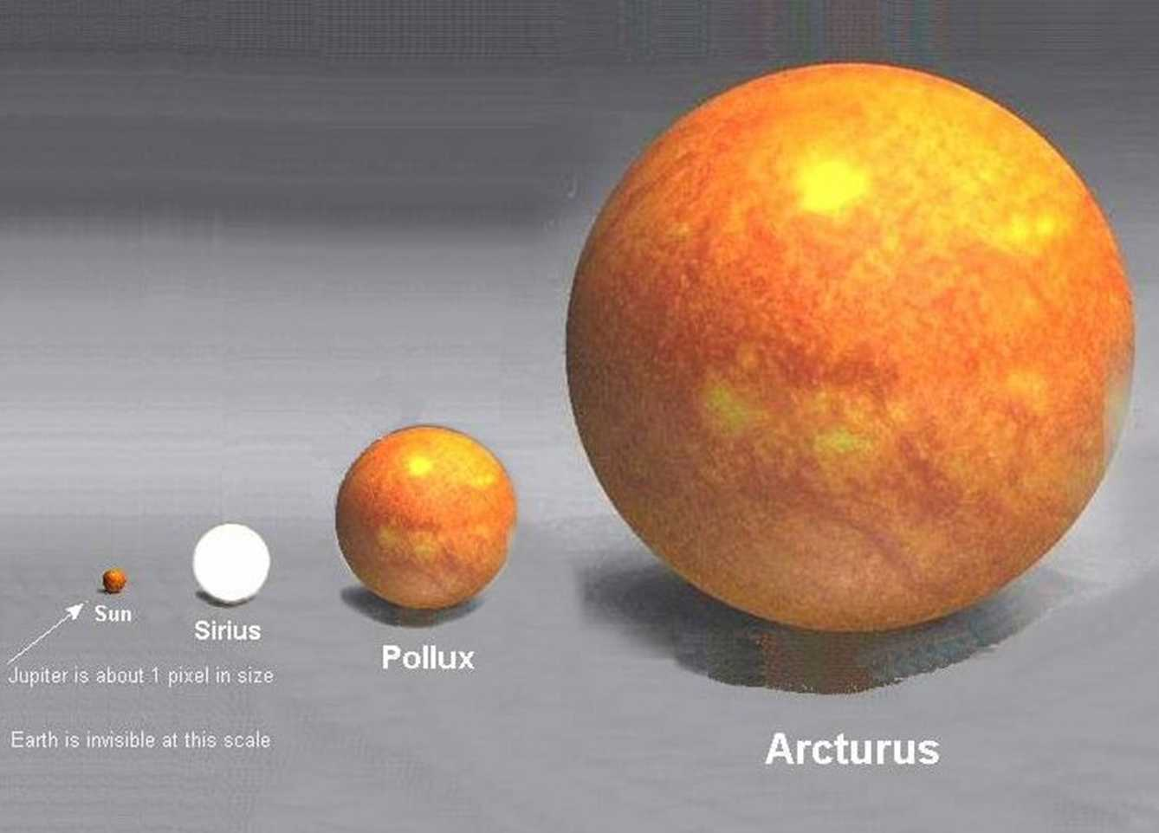

Slide 8
How far away is the Sun?
The Sun is about 93 million miles away from Earth.
It would take a jet (going about 550 mph) over 19 years to reach the Sun
A person walking at a normal pace (3 mph) would take over 6,300 years to reach the Sun
Now that you know how far away the Sun is, what does this tell you about:
- The Sun's size?
- The amount of energy the Sun puts out?

Slide 9
The Sun is a fiery ball of hot gases with no hard surfaces. Can you land on the Sun?
Why does the Sun appear so big and bright from Earth?
What is the source of most of the thermal and light energy on Earth?

Slide 10
The Sun
write these notes down!
Most of Earth's thermal (heat) and light energy comes from the Sun
The Sun is the largest star in our Solar System
The Sun is a ball of hot gases
The Sun is very far away, but looks large to us because it is extremely large

Slide 11
Why do we need energy from the Sun?
Plants need sunlight! What would happen if there were no plants?

